Slide 1
Collegiate High School
Overview
February 9, 2023

Slide 2
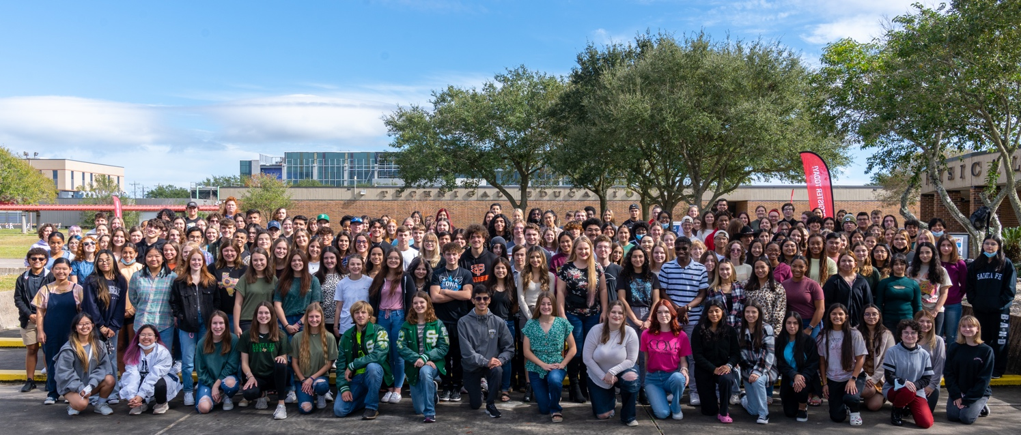
Participating Local Education Agencies
Clear Creek ISD
Dickinson ISD
Friendswood ISD
Hitchcock ISD
Odyssey Academy
Santa Fe ISD
Texas City ISD
Collegiate High School

Slide 3
Mission
It is the mission of the Collegiate High School to prepare high school students to earn college credits in order to achieve their goals by providing a rigorous foundation of academic, interpersonal, and work-readiness skills, leading to further education and employment in high demand occupations in the state and global economies.
Collegiate High School

Slide 4
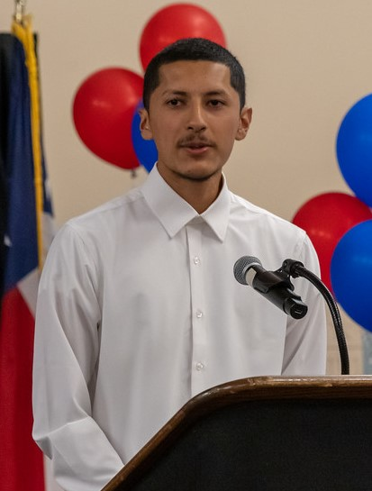
CHS at a Glance
Location:
All classes taken at College of the Mainland
Target Students:
Students who want the rigor and challenge of college courses, first generation college students, underserved student populations and students from families of low socio-economic status
Goal:
All students will work toward high school graduation and associate degree requirements simultaneously
Collegiate High School

Slide 5
CHS at a Glance
Students are enrolled as full time college students and take a minimum of 12 college hours a semester.
Students may begin taking college classes as early as their ninth-grade year based on their school district’s policy.
CHS students have a 40 percent tuition waiver.
(12 hours is approximately $500)
Textbook lending library (Inclusive access, OER-Open Educational Resources)
Collegiate High School

Slide 6
CHS at a Glance
College Transition classes (student success classes) provide students with activities to learn how to be successful in college and the workplace.
Participation in high school and college extra-curricular activities is encouraged
CHS Graduation Banquet and public high school graduation ceremonies with CHS cords
Collegiate High School

Slide 7
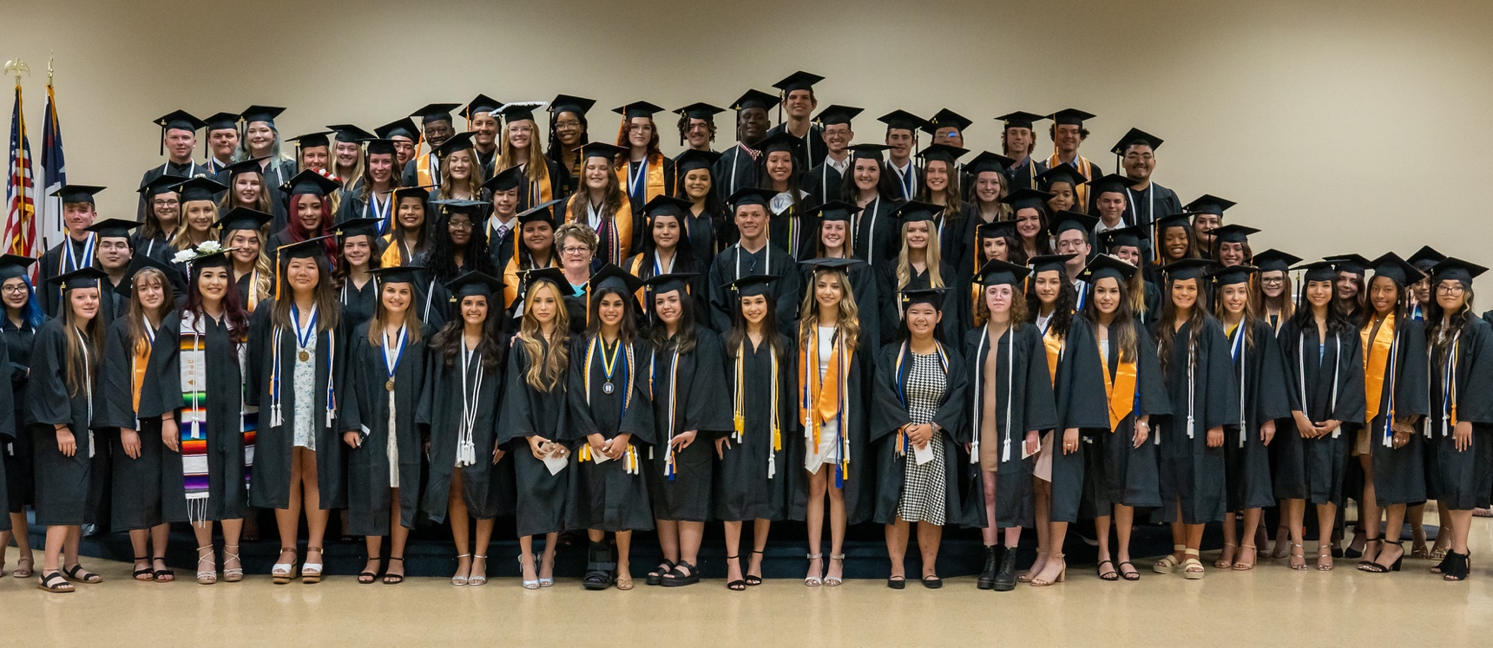
Admissions Requirements
Junior or senior classification or permission from high school
Passing all state assessments
Prefer completion of Algebra I
College reading level
Collegiate High School

Slide 8
Admissions Requirements
Student:
1. Meet with high school counselor for school procedures
2. Complete online application for COM (ApplyTexas)
3. Pass the TSIA2 Assessment (ACT/SAT/PSAT/EOC)
Prepare for the test: https://tsia2.pearsonperspective.com
4. Complete CHS application (www.com.edu/chs)
5. Parents sign and complete recommendation form
6. Forward teacher, counselor and assistant principal recommendations
7. Write a personal essay
8. Submit completed application to your high school campus counselor or to the CHS office for private school students
9. Meningococcal Meningitis Vaccination required
Collegiate High School

Slide 9
Admissions Requirements
High School Counselor
1. Special needs or 504 (documentation)
2. Official transcript
3. Copies of Qualifying College Readiness Scores
10th grade PSAT/SAT/ACT/EOC, College Bridge Certificate, On Ramps (Transcribed on HS transcript and UT Transcript sent to COM Admissions)
4. Immunization Records
5. Review and approve completed applications
6. Forward to Collegiate High School
Collegiate High School
1. Review application (Data Input): Test scores and immunization records submitted to admissions. Admissions converts them to a COM student.
Then, CHS converts them to a CHS student
2. Student and parent interview
3. CHS Staff will make the final decision
Collegiate High School

Slide 10
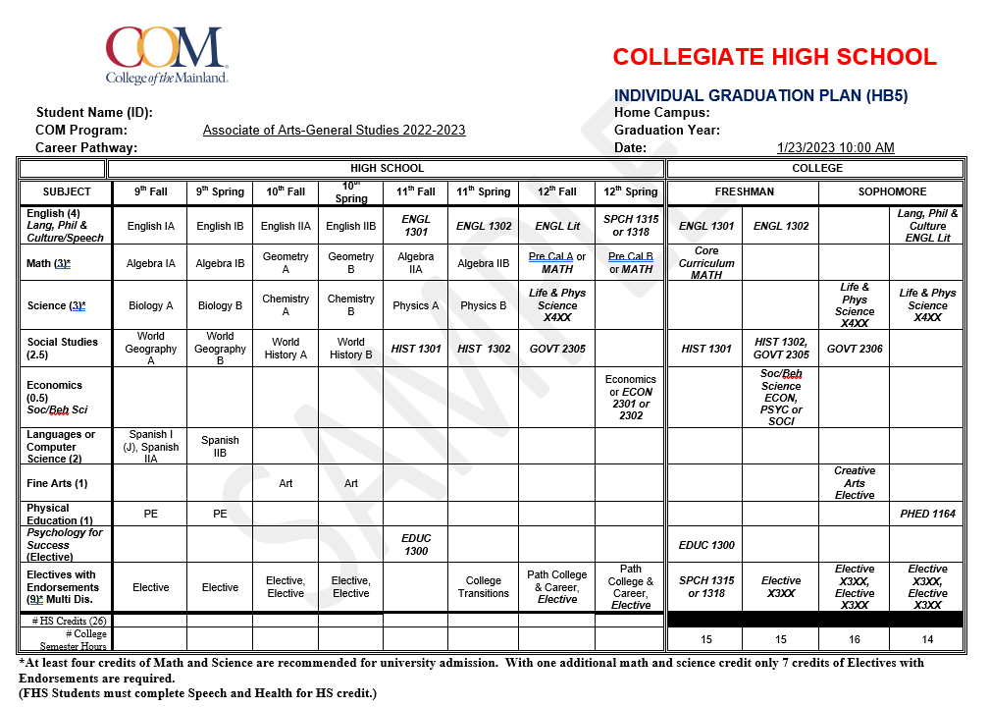
Collegiate High School

Slide 11
Collegiate High School

Slide 12
2021-2022 College Grades
51%
25%
16%
4%
3%
Collegiate High School

Slide 13
Other Components
College Workshops/Seminars
Employability Skills
Portfolios
CHS Success Course
Extra-curricular activities
University, educational, community events
Collegiate High School

Slide 14
Critical Success Factors
High Academic Standards
Maturity
Self-Motivation
Responsibility
Goal Oriented
Collegiate High School

Slide 15
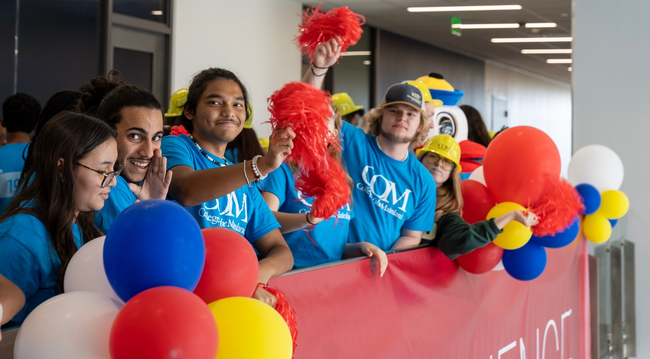
Nu Psi
Heart Walk
Ronald McDonald House
Toy drives
Food drives
Cards for Texas Children’s Hospital
Collegiate High School

Slide 16
Opening Doors Promise Scholarship
What is it?
The Opening Doors Promise Scholarship is a “last-dollar” scholarship opportunity that covers the cost of tuition and fees for any eligible graduating high school student pursuing full-time studies at COM.
Participating students can earn an associate degree or complete a workforce training certificate program.
Participating Communities
Texas City
La Marque
Hitchcock
Santa Fe
Dickinson

Slide 17
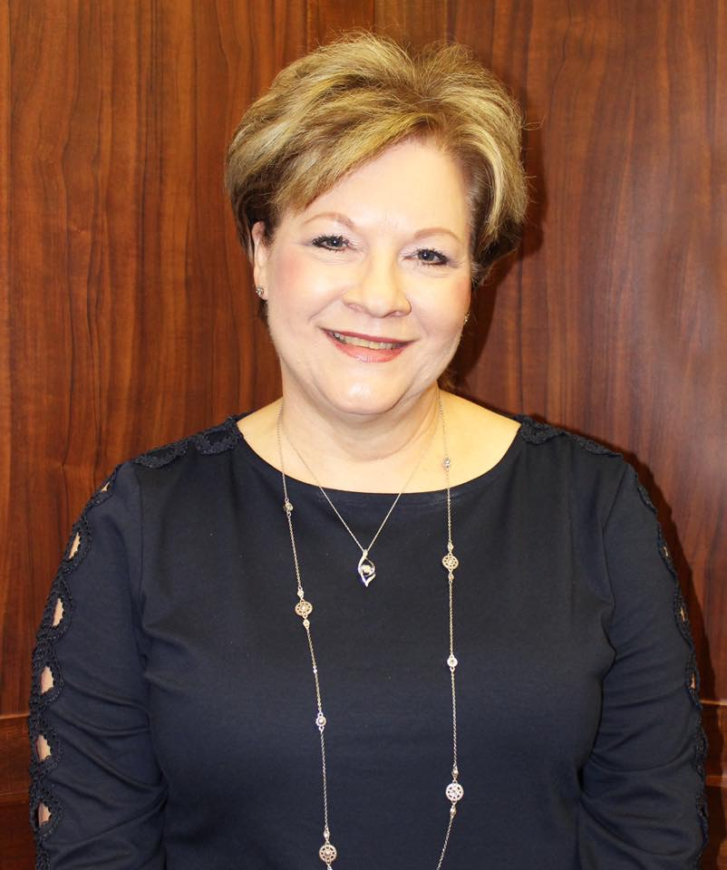
Participation of Dickinson ISD students in Collegiate High School continues to increase each year. Students' complete courses at College of the Mainland that meet high school requirements and earn college credit at the same time. Many of our students graduate with an Associate of Arts degree before they receive their high school diploma. Collegiate High School provides our students with the challenge of college-level work, and it provides guidance and support to help students transition to college life. In addition, students and parents save a substantial amount of money on tuition because of our partnership with College of the Mainland.
Carla Voelkel
Superintendent
Dickinson ISD
Collegiate High School

Slide 18
Contact Information:
Sandi Belcher, Director
409-933-8158
Ramona Wadding, Administrative Assistant
409-933-8169
CHS Application:
www.com.edu/chs (link is towards the bottom on left side)
TSIA2 Practice Test Sites:
https://tsia2.pearsonperspective.com
Collegiate High School

